Slide 1
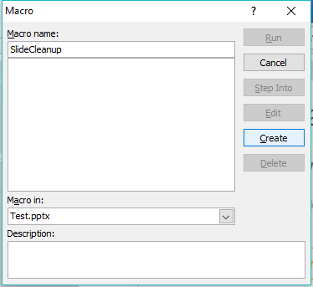
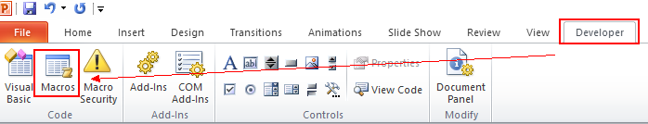
Reduce PPT file size(1/2)
Step 1. Open Macros in PPT
Step 2. Create new macro

Slide 2
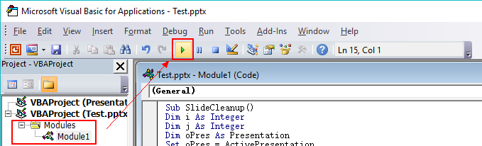
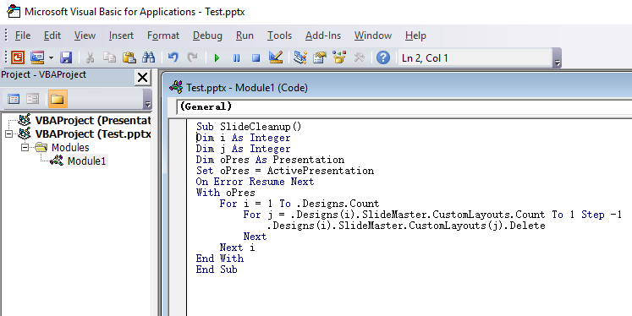
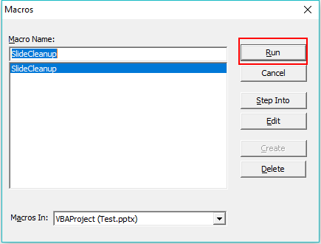
Reduce PPT file size(2/2)
Step 3. Edit VBA sources
Step 4. Run the macro

Slide 3
Source
Sub SlideCleanup()
Dim i As Integer
Dim j As Integer
Dim oPres As Presentation
Set oPres = ActivePresentation
On Error Resume Next
With oPres
For i = 1 To .Designs.Count
For j = .Designs(i).SlideMaster.CustomLayouts.Count To 1 Step -1
.Designs(i).SlideMaster.CustomLayouts(j).Delete
Next
Next i
End With
End Sub

Slide 4


Slimming effect in PPT
Before(18.5MB)
After(11.3MB)

Slide 5
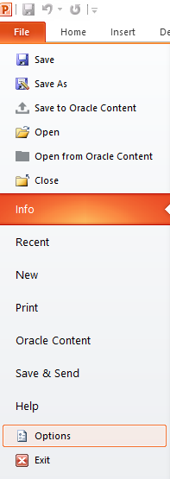
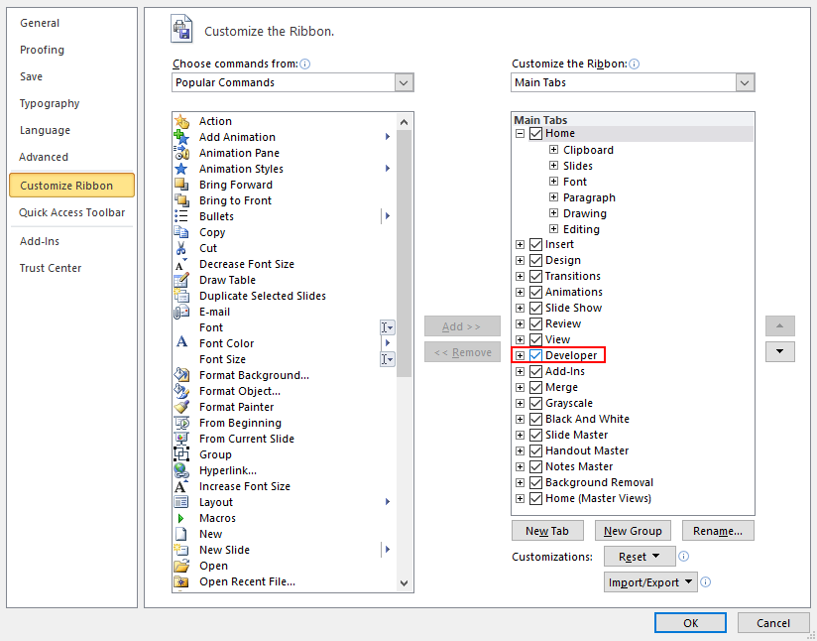
Show Developer in PPT

